Slide 1
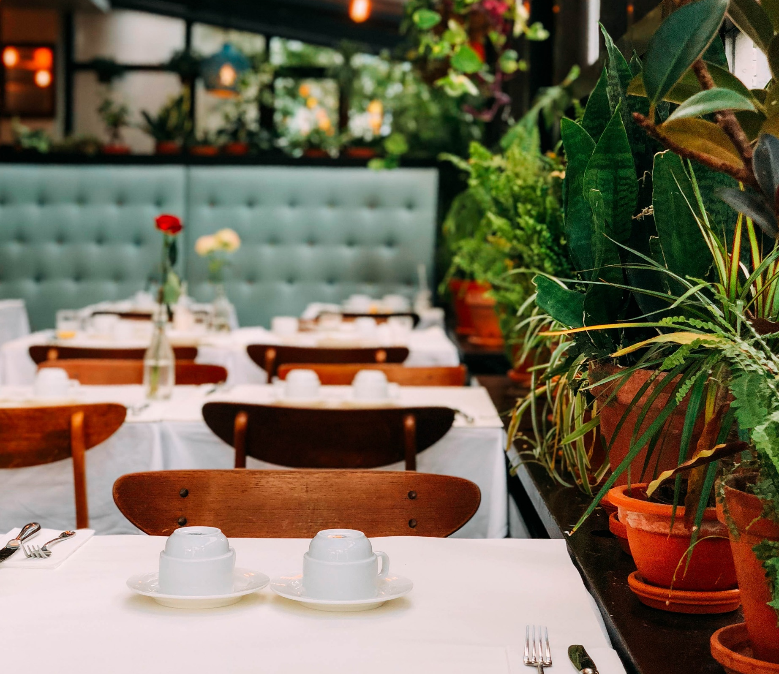
Restaurant Recommender System
Brainstation Capstone
Progress Standup
Diane Lu

Slide 2
PROBLEM STATEMENT
“
Craft a user-friendly restaurant recommendation system that understands individual preferences, resulting in delightful dining experiences and stronger customer loyalty.
”
Notes:
What is your problem statement?
Craft a user-friendly restaurant recommendation system that understands individual preferences, resulting in delightful dining experiences and stronger customer loyalty.

Slide 3
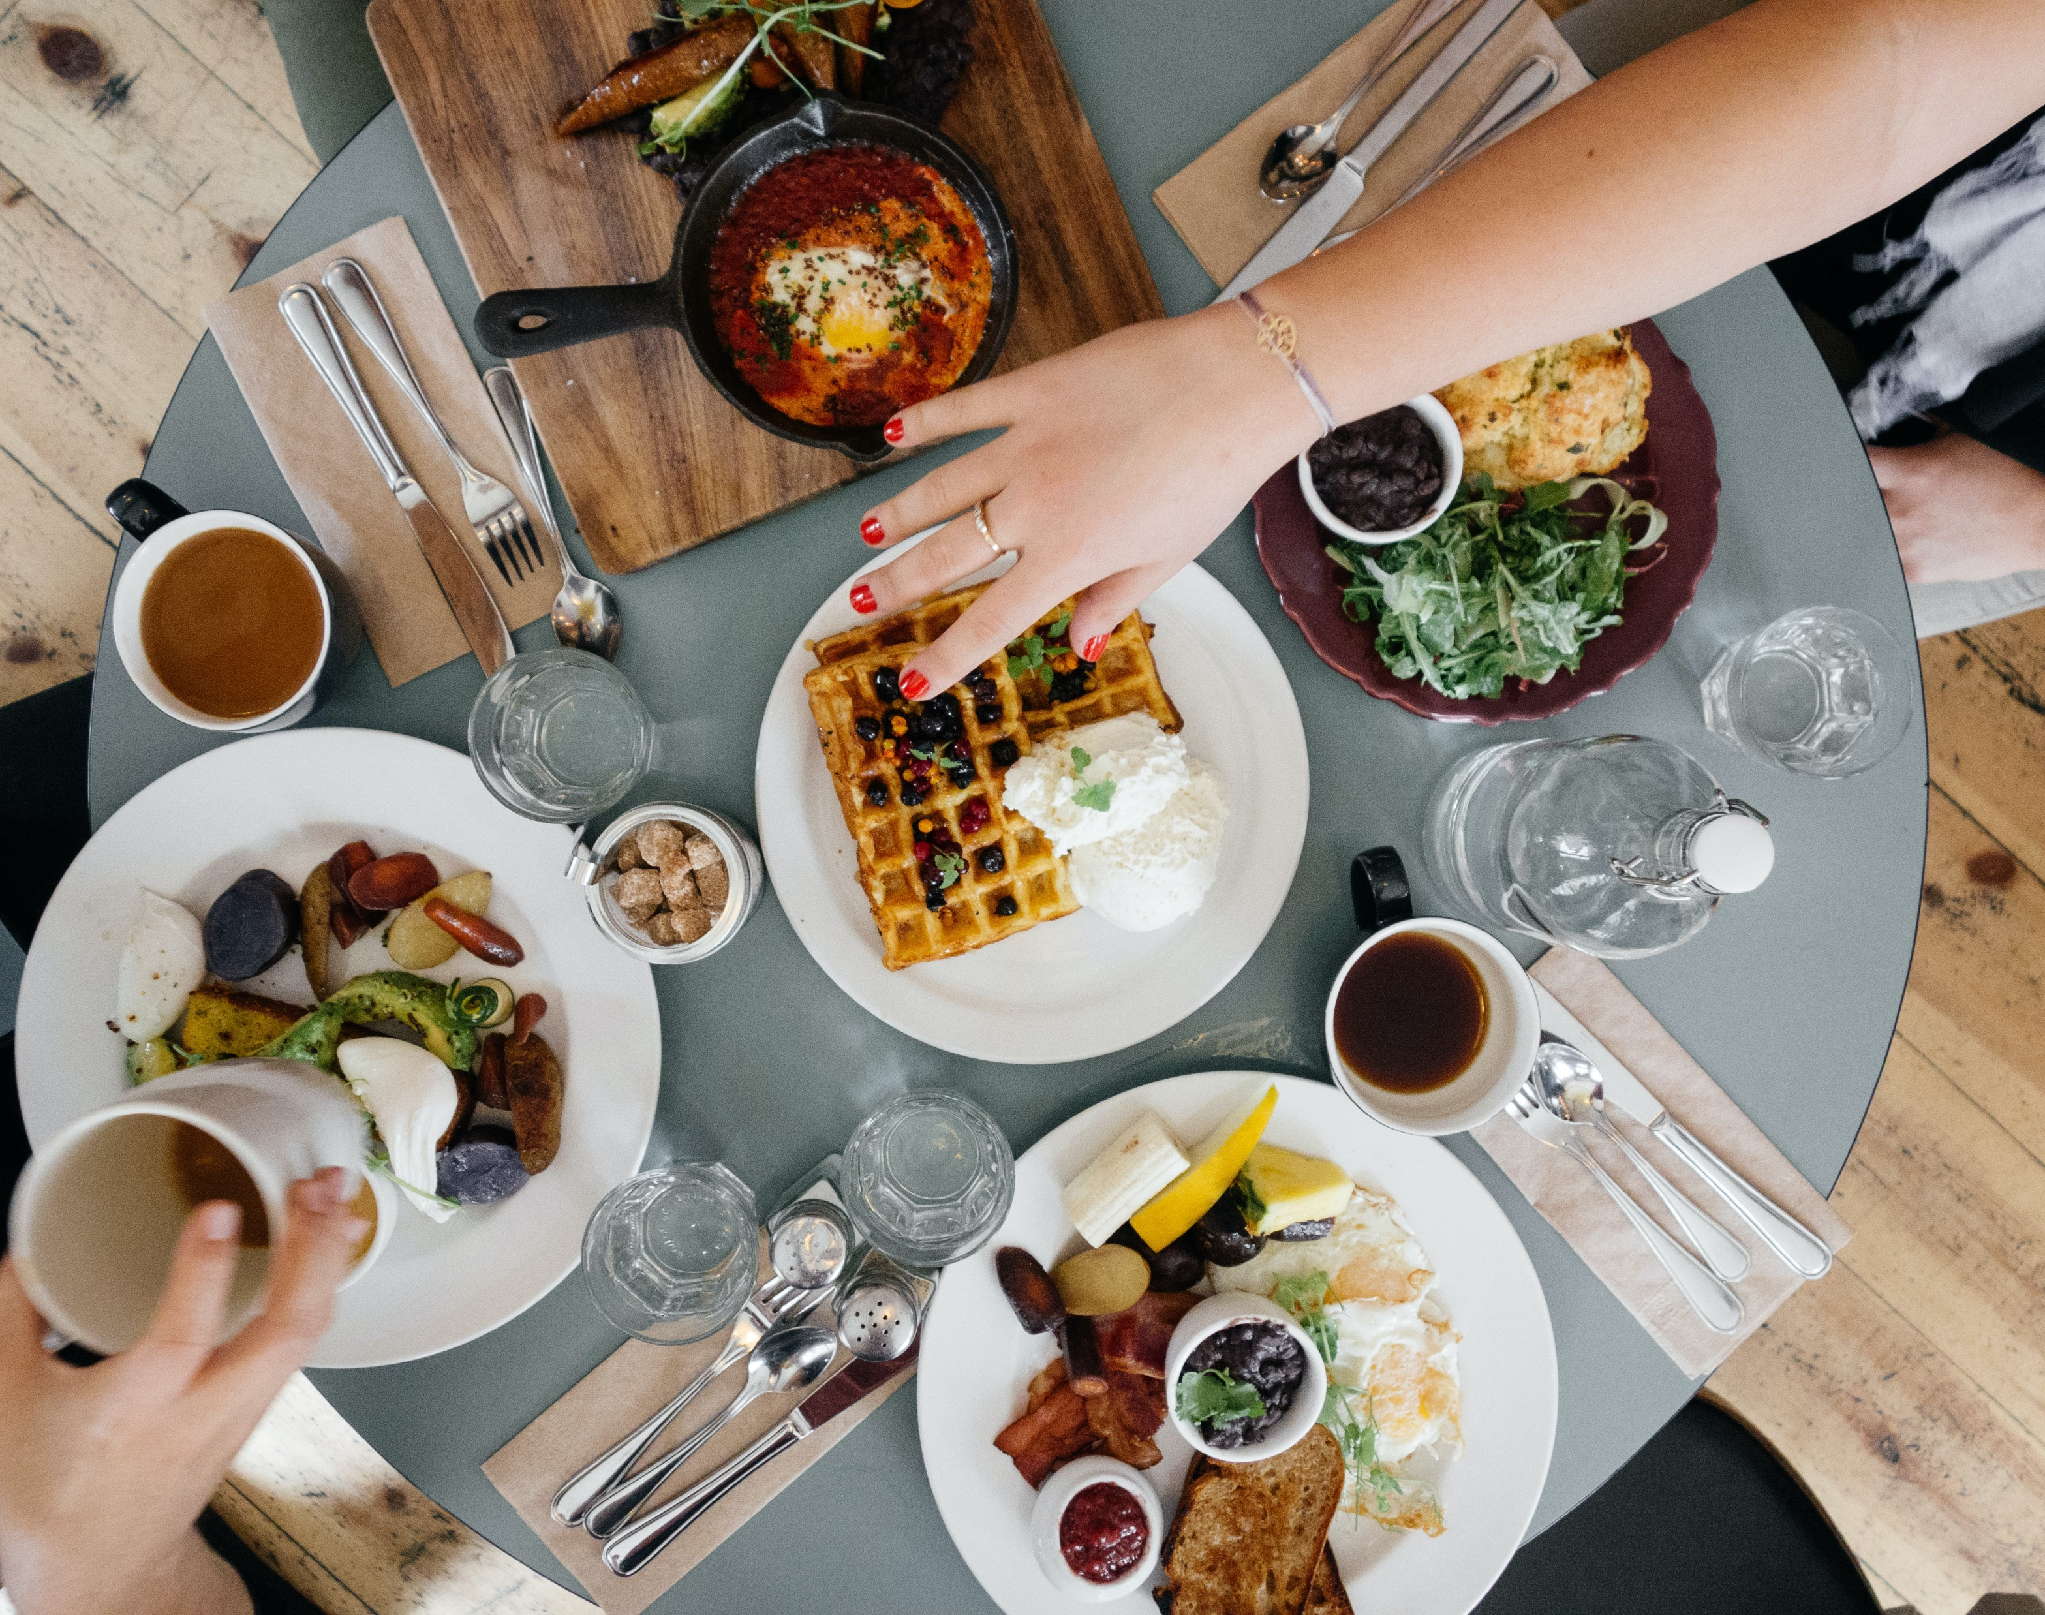
VALUE IN RESTAURANTS
Personalized dining suggestions based on individual preferences
Potential to attract new patrons through targeted recommendations
Improved user engagement and exploration of new dining options
Valuable insights into customer behavior and dining preferences
Notes:
What value are you adding?
The project's value lies in a personalized and user-friendly restaurant recommendation system that boosts customer satisfaction, fosters loyalty, and promotes the exploration of new dining options. By tailoring suggestions to individual preferences, users enjoy delightful dining experiences, potentially attracting new customers to restaurants.

Slide 4
DATA COLLECTION
Data Source
Data sourced from Yelp, a renowned platform for business reviews and recommendations
Our analysis will primarily utilize datasets related to Yelp's businesses, reviews, and users to gain valuable insights
Data Collection
Data collection involved sourcing datasets from Kaggle, which were provided directly by Yelp.
This approach ensures reliability and comprehensiveness in deriving valuable insights for the project
Notes:
Where did you get your data?
The data for our project is sourced from Yelp, a prominent online platform for business reviews and recommendations. Specifically, we will focus on leveraging the datasets related to Yelp's businesses, reviews, and users to develop a comprehensive and insightful study.
How did you collect it?
The data collection process involved sourcing the datasets from Kaggle, which were originally provided by Yelp. These datasets ensure a reliable and comprehensive foundation for deriving valuable insights for the project.

Slide 5

DATA DESCRIPTION
The Business dataset:
Information on businesses including names, addresses, locations, ratings, categories, and other attributes
The User dataset
Information including unique users, user’s first names, and average ratings of all reviews
The Review dataset
Information on unique reviews and users, star ratings, review text
Notes:
What do the data points represent?
The business dataset offers details about businesses such as names, addresses, ratings, categories, and other attributes. In contrast, the user dataset provides unique user IDs, user first names, and average ratings of all reviews, enabling us to gain valuable insights into users' preferences. Lastly, the Review dataset plays a pivotal role by offering valuable insights into user feedback and sentiments regarding various businesses, shaping our understanding of customer experiences.

Slide 6
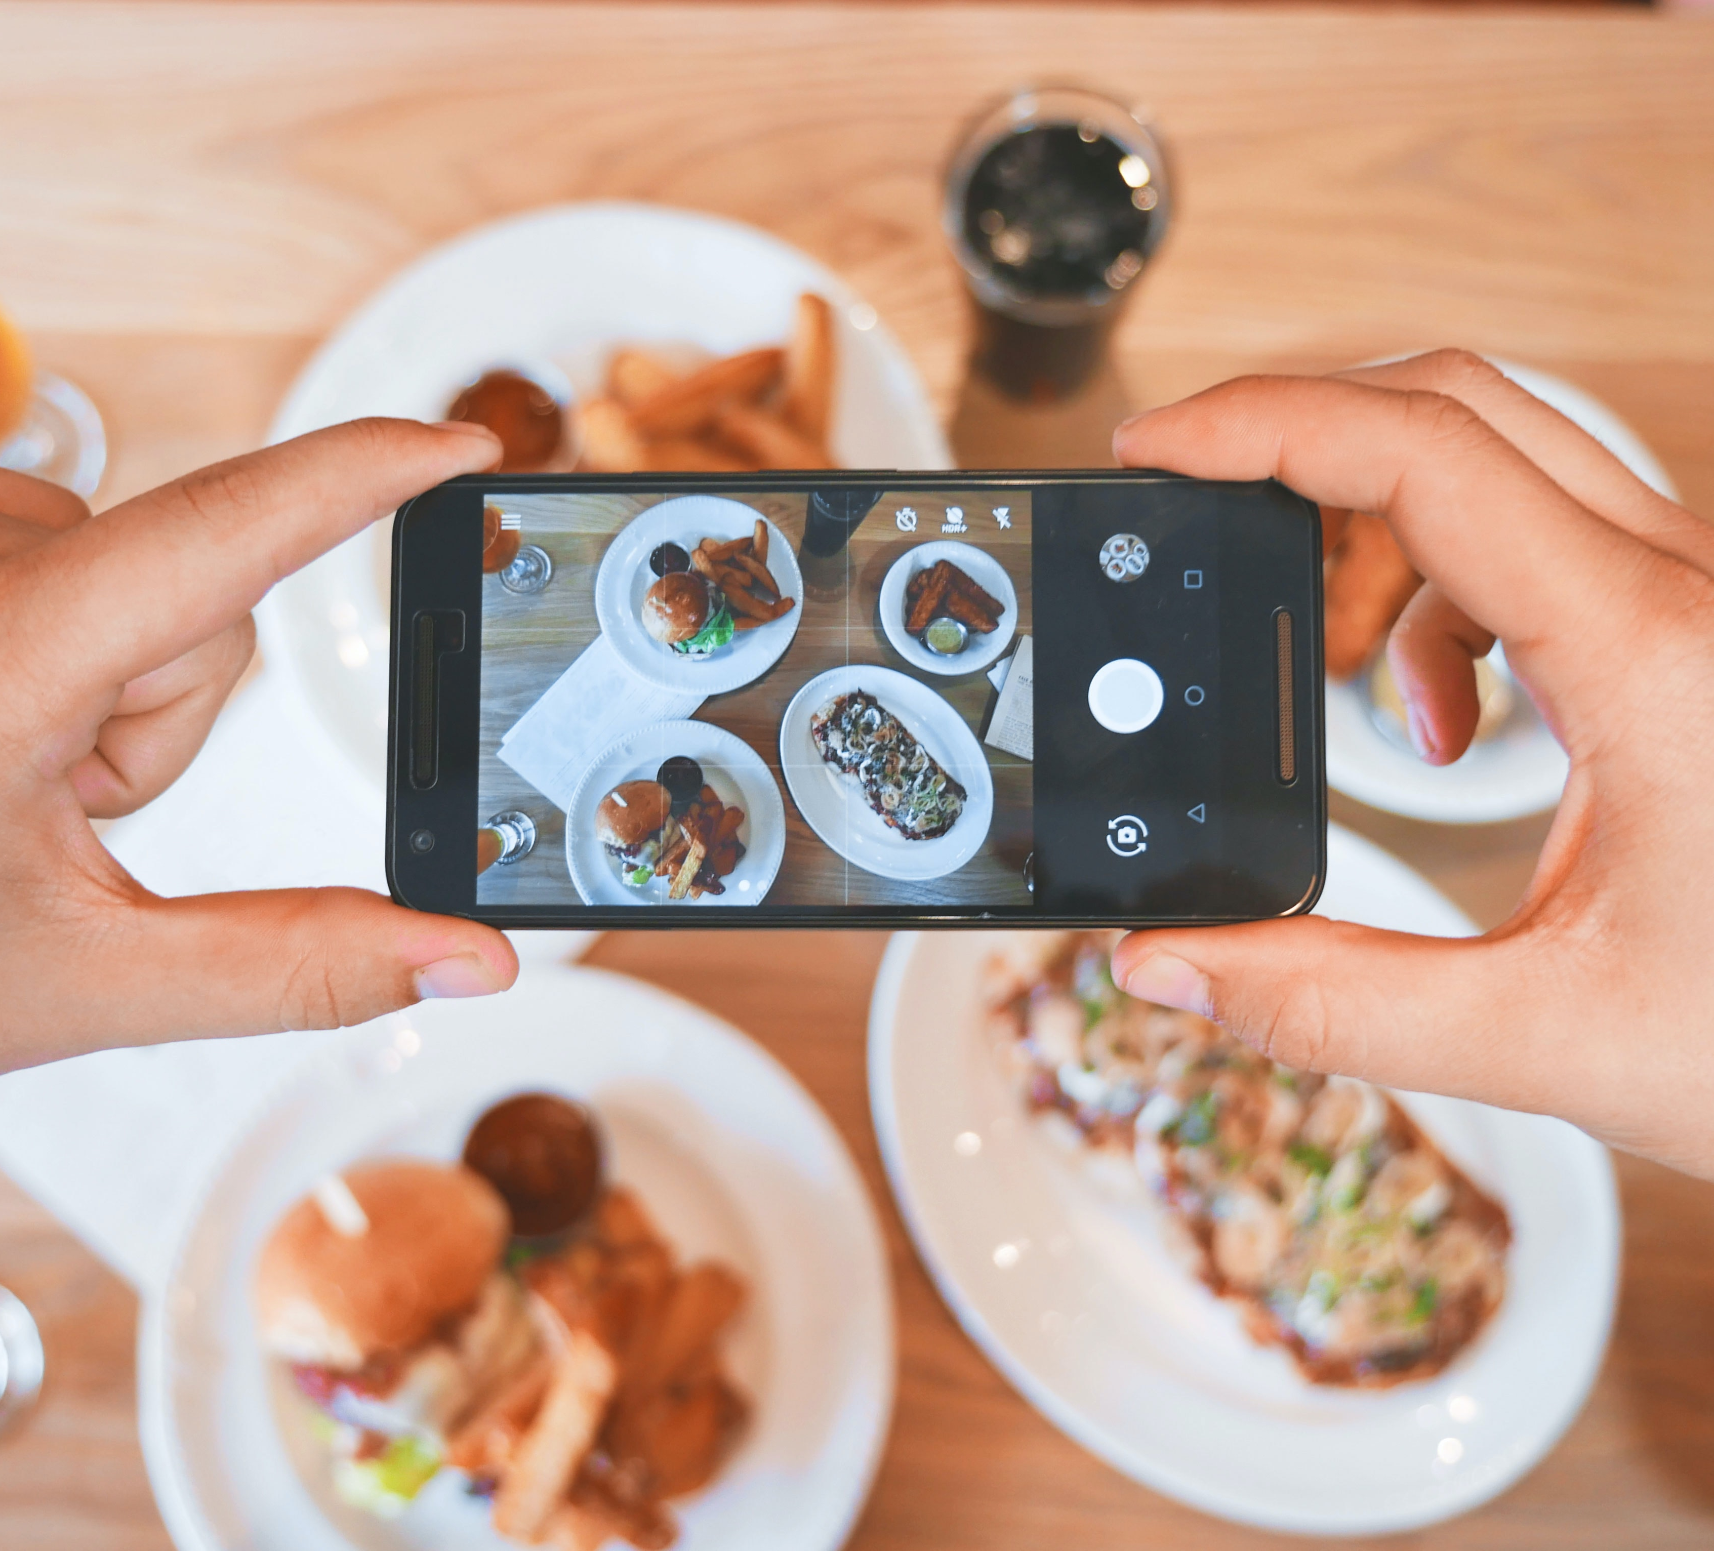
USER-BASED INFORMATION
Goal: Provide personalized restaurant suggestions to enhance the user's dining experience
Features: Ratings or interactions given by users to different restaurants
Target: Recommending restaurants that a specific user might like based on their past interactions and preferences
Notes:
What are your features and target (if applicable)
Our primary objective is to enhance the user's dining experience by offering personalized restaurant suggestions. To achieve this, we will leverage user ratings and interactions with various restaurants as the key features in our recommendation system. The system's target is to predict or recommend restaurants that align with a specific user's tastes, based on their past interactions and dining preferences with other restaurants. By tailoring recommendations to individual users, we strive to create a seamless and delightful dining journey for each user.

Slide 7

CLEANING THE DATASETS
Data cleaning steps completed for Business, Users, and Reviews datasets
The non-restaurant entries have been removed from all three datasets during the initial data cleaning steps
Handled missing values through appropriate imputation or removal
Identified and eliminated duplicate entries to ensure data integrity
Notes:
What clean-up steps have been completed so far?
Initial data cleaning steps have been completed for the three datasets. The data cleaning process involved handling missing values by imputing or removing them appropriately. Duplicates were identified and eliminated to ensure data integrity. Additionally, inconsistencies in data entries, such as variations in text format, were addressed and standardized.

Slide 8

OVERVIEW OF DATASETS
The Business dataset: 50,764 entries with 12 columns
The User dataset: 2,189,457 entries with 3 columns
The Review dataset: 8,635,400 entries with 5 columns
The Final dataset: 5,574,714 entries with 18 columns
Notes:
How many data points and columns did you start and end with?
The final dataset, comprising 5.5 million entries and 18 columns, underwent thresholding to streamline its size and focus on relevant data. We specifically considered restaurants with at least 100 reviews and users who contributed more than 50 reviews. This selection process ensures that we prioritize restaurants and users with substantial interactions, resulting in a more meaningful and insightful analysis for our restaurant recommendation system.

Slide 9
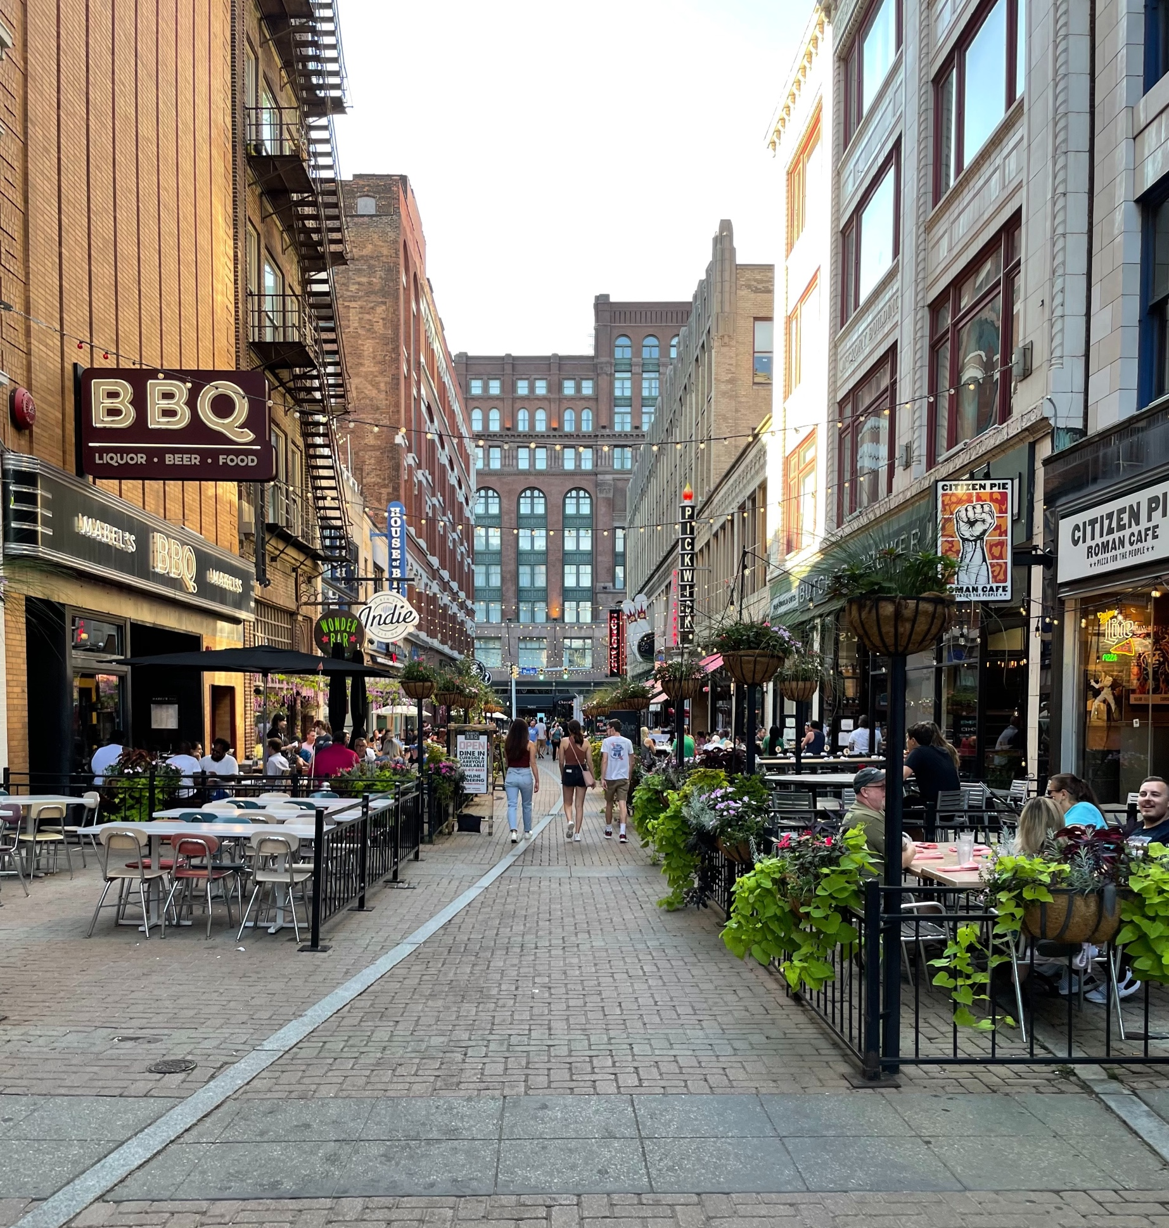
MACHINE LEARNING MODEL
User-based Collaborative Filtering Recommender System
User-based collaborative filtering model provided personalized restaurant suggestions based on user-item interactions
Initial evaluations showed that the model recommended restaurants aligned with users' tastes, enhancing the overall dining experience
Notes:
Which models have you tried so far?
As of the current, the user-based collaborative filtering recommender system has been implemented as the primary model for restaurant recommendations. Preliminary results indicate that the model successfully provides personalized restaurant suggestions based on user-item interactions. These suggestions align with users' tastes, resulting in an improved overall dining experience. However, further analysis and evaluation are required to fine-tune the model and enhance its accuracy and performance.

Slide 10
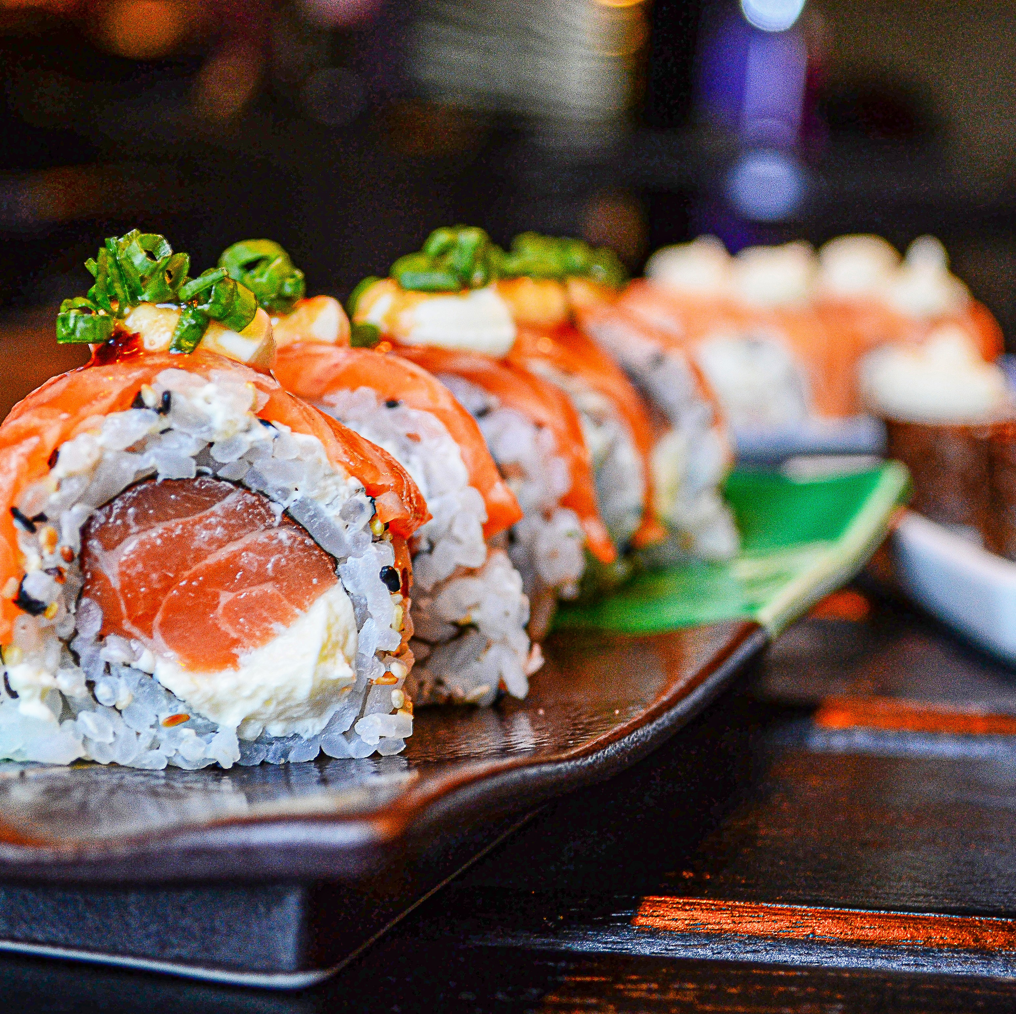
CASE EXAMPLE
Recommendation based on the restaurant Suika
Recommended Restaurants:
Kishimoto Japanese Kitchen
Hokkaido Ramen Santouka
Phnom Penh
Kingyo
Notes:
Show some preliminary results.
I decided to run our recommender on a local Japanese restaurant in Vancouver, BC – Suika. The recommendations returned were: Kishimoto Japanese Kitchen, Hokkaido Ramen Santouka, Phnom Penh, and Kingyo. Three of the four recommended restaurants are Japanese just like Suika, where Phnom Penh is Cambodian – all of which are Asian cuisines. More specifically, Kingyo is a sister restaurant to Suika.

Slide 11
PLAN OF ACTION
Further analysis and evaluation to enhance model accuracy and performance
Utilize Singular Value Decomposition (SVD) for handling sparse data and missing values in the user-item matrix
Train the model on the training set and evaluate using metrics based on the User-Item Interaction Matrix
Fine-tune the number of latent features and hyperparameters to optimize the collaborative filtering-based recommendation system
Notes:
What is your plan for the next two weeks?
To enhance the model's accuracy and performance, we will conduct further analysis and evaluation. Utilizing Singular Value Decomposition (SVD), we can effectively handle sparse data and address missing values in the user-item matrix. The model will be trained on the training set and evaluated using appropriate metrics based on the User-Item Interaction Matrix. Additionally, we will fine-tune the number of latent features and other hyperparameters to optimize the model's performance in our collaborative filtering-based recommendation system.

Slide 12
The end

